Slide 1
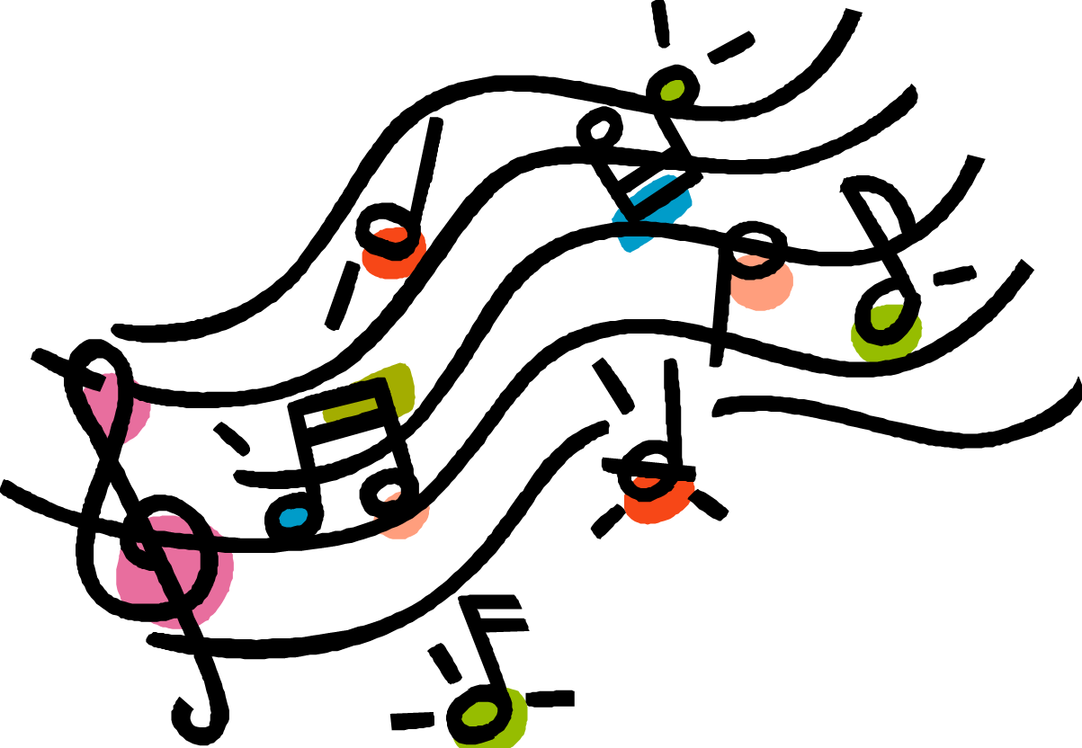
13 Nights of Halloween
6th grade Music

Slide 2
On the 1st night of Halloween
Some witches gave to me:
Some bones from a haunted graveyard.

Slide 3
On the 2nd night of Halloween
Some witches gave to me:
2 zombie eyeballs.
And some bones from a haunted graveyard.

Slide 4
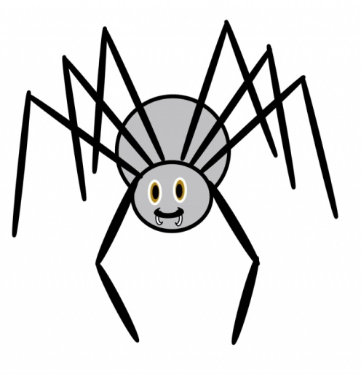
On the 3rd night of Halloween
Some witches gave to me:
3 giant spiders.
2 Zombie Eyeballs
And some bones from a haunted graveyard.

Slide 5
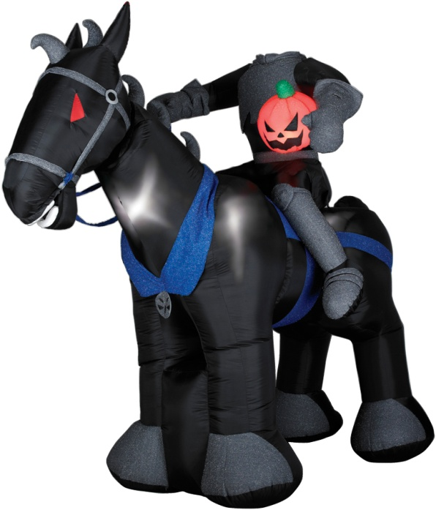
On the 4th night of Halloween
Some witches gave to me:
4 headless horsemen.
3 giant spiders
2 Zombie Eyeballs
& some bones from a haunted graveyard.

Slide 6
On the 5th night of Halloween
Some witches gave to me:
5 creepy Dolls!!!
4 headless horsemen
3 giant spiders
2 Zombie Eyeballs
& some bones from a haunted graveyard.

Slide 7
On the 6th night of Halloween
Some witches gave to me:
6 vampires biting

Slide 8
5 creepy Dolls!!!
4 headless horsemen
3 giant spiders
2 Zombie Eyeballs
& some bones from a haunted graveyard.

Slide 9
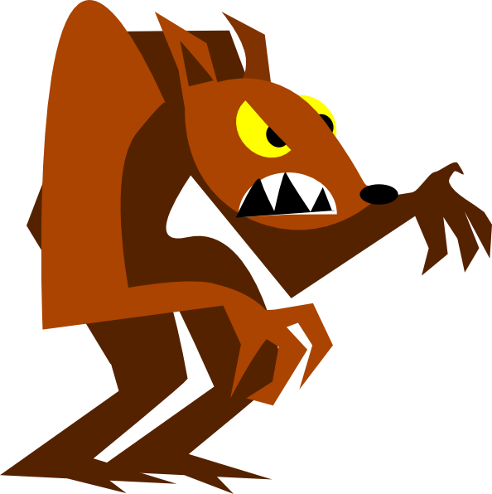
On the 7th night of Halloween
Some witches gave to me:
7 werewolves howling
How-oooool
6 vampires biting

Slide 10
5 creepy Dolls!!!
4 headless horsemen
3 giant spiders
2 Zombie Eyeballs
& some bones from a haunted graveyard.

Slide 11
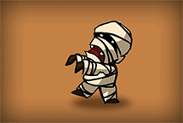
On the 8th night of Halloween
Some witches gave to me:
8 mummies walking
7 werewolves howling
6 vampires biting

Slide 12
5 creepy Dolls!!!
4 headless horsemen
3 giant spiders
2 Zombie Eyeballs
& some bones from a haunted graveyard.

Slide 13
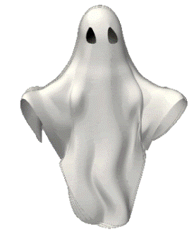
On the 9th night of Halloween
Some witches gave to me:
9 ghosts haunting
8 mummies walking
7 werewolves howling
6 vampires biting

Slide 14
5 creepy Dolls!!!
4 headless horsemen
3 giant spiders
2 Zombie Eyeballs
& some bones from a haunted graveyard.

Slide 15
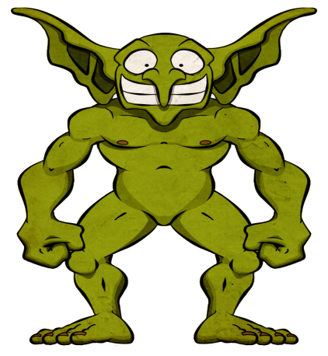
On the 10th night of Halloween
Some witches gave to me:
10 goblins glowing
9 ghosts haunting
8 mummies walking
7 werewolves howling
6 vampires biting

Slide 16
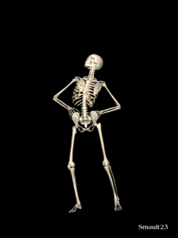
5 creepy Dolls!!!
4 headless horsemen
3 giant spiders
2 Zombie Eyeballs
& some bones from a haunted graveyard.

Slide 17
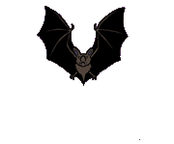
On the 11th night of Halloween
Some witches gave to me:
11 bats a flying

Slide 18
10 glowing goblins
9 ghost haunting
8 mummies walking
7 werewolves howling
6 vampires biting

Slide 19
5 creepy Dolls!!!
4 headless horsemen
3 giant spiders
2 Zombie Eyeballs
& some bones from a haunted graveyard.

Slide 20
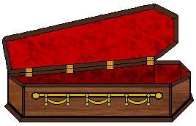
On the 12th night of Halloween
Some witches gave to me:
12 coffins creaking
11 bats a flying

Slide 21
10 glowing goblins
9 ghost haunting
8 mummies walking
7 werewolves howling
6 vampires biting

Slide 22
5 creepy Dolls!!!
4 headless horsemen
3 giant spiders
2 Zombie Eyeballs
& some bones from a haunted graveyard.

Slide 23
On the 13th night of Halloween
Some witches gave to me:
13 cauldrons bubbling
12 coffins creaking
11 bats a flying

Slide 24
10 glowing goblins
9 ghost haunting
8 mummies walking
7 werewolves howling
6 vampires biting

Slide 25
5 creepy Dolls!!!
4 headless horsemen
3 giant spiders
2 Zombie Eyeballs

Slide 26
& some bones from a haunted graveyard!!!!

