Slide 1
Ratios Module 1: Lesson 10

Slide 2
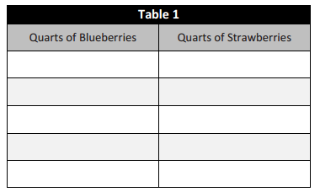
You are making a fruit salad. For every quart of blueberries you add, you will put in 3 quarts of strawberries. Create a ratio table to show the amounts of blueberries and strawberries that you would use if you needed to make a fruit salad for more people
1
=
3
Quarts of Blueberries
Quarts of Strawberries
Fill in the table for 4 different amounts where you would use 10-50 quarts of blueberries.
Fill in the table for 4 different amounts where the blueberries are greater than 100 quarts
Fill in the table for 4 different amounts where you would add 10 fewer quarts of strawberries to the salad.
1
3

Slide 3
What patterns can you see in the tables?
How are the amounts of blueberries and strawberries related to each other?
1:3
How are the values in the blueberries column relate to each other?
How are the values in the strawberries column relate to each other?
If we add 7 quarts of blueberries to the fruit salad in the top table how will we decide how many strawberries to add?
If we use 70 quarts of blueberries how can we use the ratio in the top table to find how many strawberries we need?

Slide 4
There are some mistakes in the tables below. Correct the mistakes and state which ratio was used to make the correct table.
Use your understanding of multiples to the Pay in Dollars
x ___=
x ___=
x ___=
x ___=
1:8

Slide 5
There are some mistakes in the tables below. Correct the mistakes and state which ratio was used to make the correct table.
If the ratio for the table is 1:5 determine if the
Amounts are correct or not ?
Use your understanding of multiples to the Pay in Dollars
x ___=
x ___=
x ___=
x ___=

Slide 6
Create a ratio table for making lemonade if the juice to water ratio is 1:3. Show how much lemon juice you would need if you used 36 cups of water to make the lemonade.
Ratio: ____ : ____
Lemon Juice | Water
How do we use the ratio the question gives us to fill in the table and come up with the solution to our question?

Slide 7
Create a ratio table for making lemonade if the juice to water ratio is 1:3. Show how much lemon juice you would need if you used 36 cups of water to make the lemonade.
Ratio: ____ : ____
Lemon Juice | Water
How do we use the ratio the question gives us to fill in the table and come up with the solution to our question?

Slide 8
Ryan made a table to show how much blue and red paint he mixed to get the shade of purple he will use to paint the room. He wants to use the table to help him make larger and smaller batches of purple paint.
4 1
Ratio: ____ : ____
BLUE | RED
12 | 3
20 | 5
28 | 7
36 | 9
What ratio was used to create this table? How can you prove this?
How are the values in each row related to each other?
How are the values in each column related to each other?

Slide 10
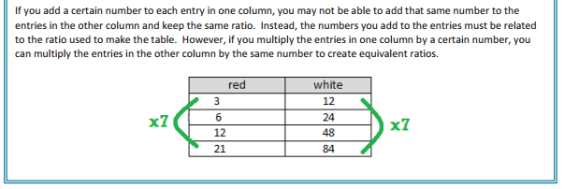

Slide 11
Homework
Due: Tuesday October 4th
exit ticket questions 1-3
6.1 Worksheet B 1-6

