Slide 1
Ratios Module 1: Lesson 14

Slide 2
Kelli is traveling from Yonkers NY, to Morgantown WV. That distance is 400 miles. The total amount of time takes 8 total hours. Use the table to show the time it will take Kelli to travel from Yonkers to each of the towns listed in the schedule if the time traveled is the same from city to city.
Time
Total Time
8 hours
How long will it take to get there and get back? Explain your answer.

Slide 3
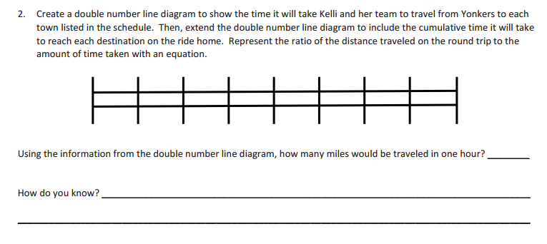
Hours
Yonkers
Morgantown
Miles
100
200
300
400
500
600
700
800

Slide 4
Use a graph, and coordinate points to plot this information on the graph
Write the hours to miles in ordered pairs:

Slide 5
If dinner is served on the train 250 miles after leaving Yonkers what time will Kelli get to eat? ____
The train will stop for a while after 11 hours. How many miles will the train have traveled up until that point? ____________

Slide 6
Change the information in the table to ordered pairs, then plot that information on the graph:
Ordered Pairs
Use the graph to predict where the next point on the graph will be?

Slide 7
Use the table below to find out how many cups of sugar will need to be used if each pie takes 2 cups of sugar each.
Ordered Pairs
Use the graph to predict where the next point on the graph will be?

Slide 8
Use the table below to find out how many cups of sugar will need to be used if 1 pie takes 3 cups of sugar each.

Slide 9
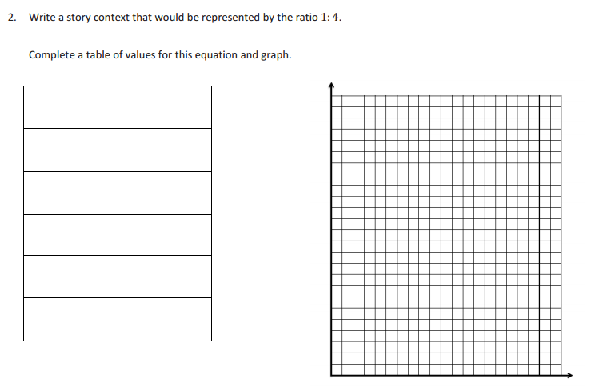
If the ratio is 1:4 complete the table, list the ratios, and plot the points on the graph to show this information:

Slide 10
Homework
Due: Friday Oct. 7th
ENY 1.14 exit ticket questions 1-2
Backside of the Worksheet

