Slide 1
Ratios Module 1: Lesson 1

Slide 2
Let’s create a table to show how many boys and how many girls could be on the team.
# of Boys | # of Girls | Total # of Players
4

Slide 3
Is this big enough for a team? What are some other ratios that show four times as many boys as girls, or a ratio of boys to girls of 4 to 1?
# of Boys | # of Girls | Total # of Players
4 | 1 | 5

Slide 4
Let’s create another table to show the possibilities. What are some other team compositions where there are three boys for every 2 girls on the team.
(Copy on your class work page.)
I can’t say there are 3 times as many boys as girls. What would my multiplicative value have to be? There are _____ as many boys as girls.
# of Boys | # of Girls | Total # of Players
3 | 2 | 5

Slide 5
Can you visualize $\frac{3}{2}$ as many boys as girls? Can we make a tape diagram that shows that there are $\frac{3}{2}$ as many boys as girls? (Click to see.)
BOYS
GIRLS

Slide 6
Which description makes the relationship easier to visualize: saying the ratio is 3 to 2 or saying there are 3 halves as many boys as girls?
BOYS
GIRLS

Slide 7
How can we say this as a multiplicative comparison without using ratios?

Slide 8
Brainteaser Questions
What can you use between the two numbers of a ratio?
2. a RATIO is a number that represents a relationship between 2 things. So, is a FRACTION a ratio???
A fraction bar, or a colon
Yes! When we see the fraction bar we can say “to” 3/15 3:15 3 to 15

Slide 9
Raise your hand when you know the ratio of girls to boys in our class. Write it on your class work page. Is the ratio of number of girls to number of boys the same as the ratio of number of boys to number of girls?

Slide 10
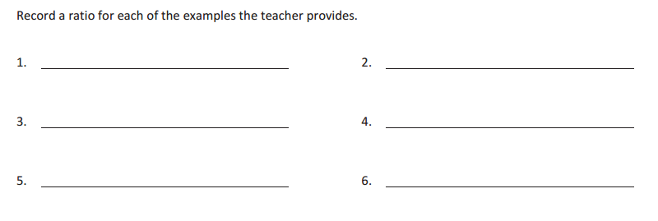
Stand if you identify with this statement:
6. Your favorite class is not math.
Stand if you identify with this statement:
5. Your favorite class is math.
Stand if you identify with this statement:
1. You traveled out of state this summer.
Stand if you identify with this statement:
3. You have at least one sibling.
Stand if you identify with this statement:
2. You did not travel out of state this summer.
Stand if you identify with this statement:
4. You are an only child.

Slide 11
Look around the classroom to find quantities to compare. Fill in your ratio statements for Exercise 1.

Slide 12
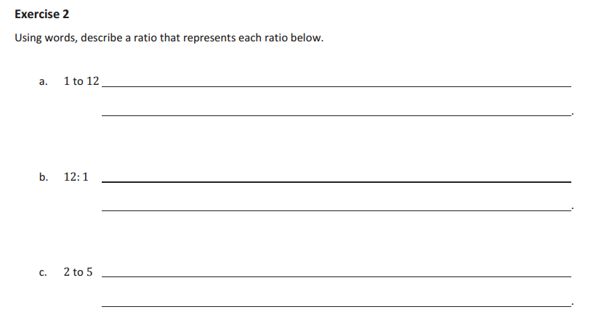
Work with a partner and use words to describe a context that
could be represented by each ratio given.

Slide 15
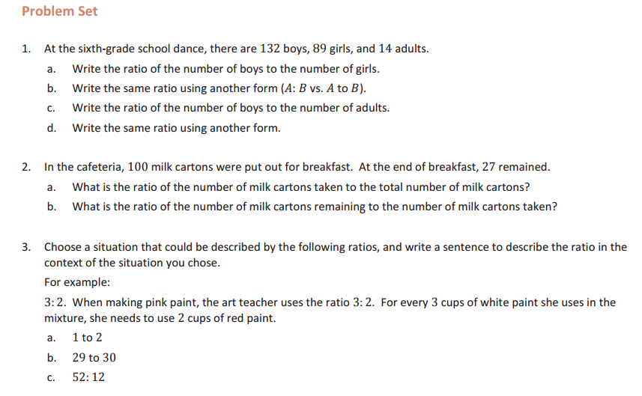

Slide 16
Homework
Due: Wednesday
exit ticket questions 1-3
(7.1) page 344 9-20

