Slide 1
Ratios Module 1: Lesson 2

Slide 2
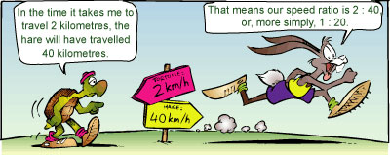
Ratios and Rates
Objective: Students will learn to write ratios and rates 3 different ways, so they are able to find unit rates. Ratios will show us how we compare 2 wholes, 2 parts, and wholes and parts

Slide 3
Vocabulary
Ratio: is when we compare 2 different groups (or numbers) using division symbols.

Slide 4
When writing ratios it is very important that the 1st item is listed First too!
RIGHT
WRONG
6:2
2:6

Slide 5
At Orion Junior High band has:
1 Harp 6 Horns
Flutes 2 Trombones
Reeds 5 Drums
4 Clarinets 9 Basses
The Ratio of Flutes to Clarinets is:
5 5 to 4 5:4
4

Slide 6
At Orion Junior High band has:
1 Harp 6 Horns
Flutes 2 Trombones
Reeds 5 Drums
4 Clarinets 9 Basses
The Ratio of Reeds to Basses is:
8 8 to 9 8:9
9

Slide 7
At Orion Junior High band has:
1 Harp 6 Horns
Flutes 2 Trombones
Reeds 5 Drums
4 Clarinets 9 Basses
The Ratio of Horns to all Instruments is:
to :

Slide 8
At Orion Junior High band has:
1 Harp 6 Horns
Flutes 2 Trombones
Reeds 5 Drums
4 Clarinets 9 Basses
The Ratio of all Instruments to Drums:
to :

Slide 9
When we have equivalent ratios we can use multiplication and division to
show how the pattern stays the same as it increases or decreases.
4:6
How can we build this pattern?
8:12
How can we make that first
Pattern smaller?
2:3

Slide 10
Show 6 other Equivalent fractions to compare the number of spades by the number of hearts shown.
:

Slide 11
Lets open our M and M’s and see if we can’t find the ratios for the colors in the package.

Slide 12
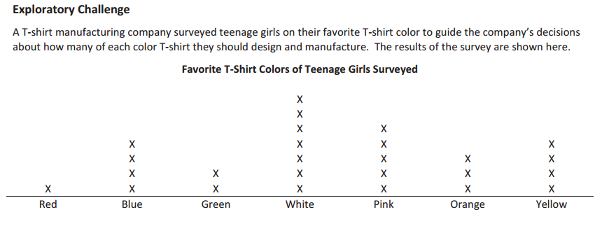
Read and study the description of the data in the chart. Without looking back a the description, what is the chart about?

Slide 13
Based on the survey, should the company order more pink fabric or more orange fabric?
What is the ratio of the number of bolts of pink fabric to the number of bolts of orange fabric you think the company should order?

Slide 14
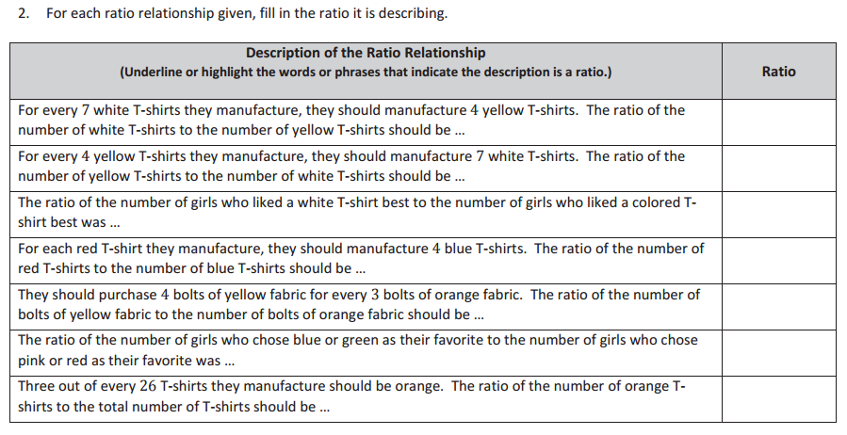

Slide 15
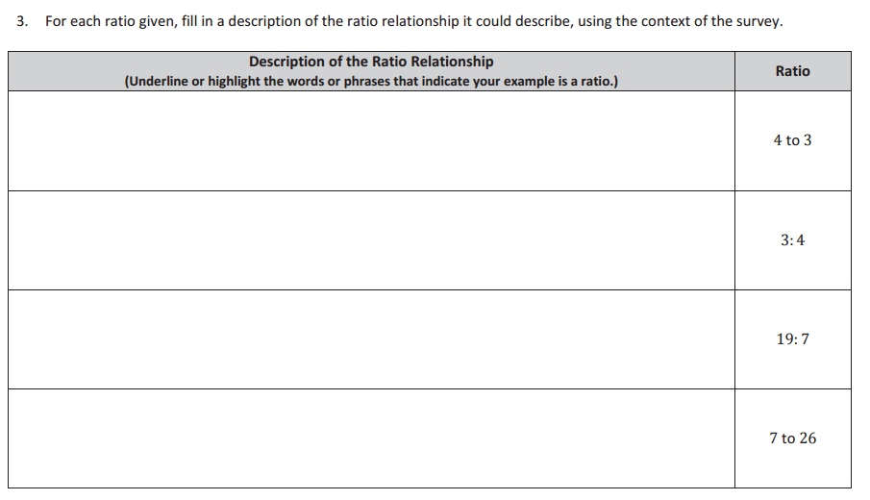

Slide 17
Homework
Due: Friday September 2nd
exit ticket questions 1-3
(7.1) page:344 1-4 and 21-25
exit ticket questions 1-3
(7.1) page:344 21-25

