Slide 1
Ratios Module 1: Lesson 3

Slide 2
Warm Up Activity

Slide 4
Let’s represent this ratio in a table.
The Length of Shanni’s Ribbon (in inches) | The Length of Mel’s Ribbon (in inches)

Slide 5
Shanni
Mel
What does each unit on the tape diagram represent?
What if each unit on the tape diagram represents 1 inch? What are the lengths of the ribbon?
What if each unit represents 3 inches? What are the lengths of the ribbon? Why?
If each of the units represents 3 inches, what is the ratio of the length of Shanni’s ribbon to the length of Mel’s ribbon?
The Length of the Ribbon
Shanni=7 in Mel= 3 in
Shanni=21 in Mel= 9 in
7:3

Slide 6
What do these three ratios have in common?
7 : 3
14 : 6
21 : 9
Mathematicians call these ratios equivalent.
What ratios can we say are equivalent to 7:3 ?

Slide 7
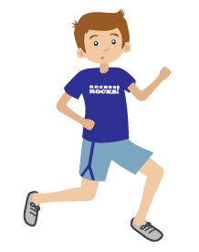
Mason and Laney have been running laps together. The ratio of laps Mason ran to the number of laps Laney ran was 2:3.
If Mason ran 4 miles, how far did Laney run. Use a tape diagram to find this answer.
2
2
=4miles
Mason
=
Laney

Slide 8
Mason and Laney have been running laps together. The ratio of laps Mason ran to the number of laps Laney ran was 2:3.
If Laney ran 930 meters how far did Mason run? Use the tape diagram to find the answer.
=
Mason
=930meters
310
310
310
Laney

Slide 9
What ratios can we say are equivalent to 2:3

Slide 10
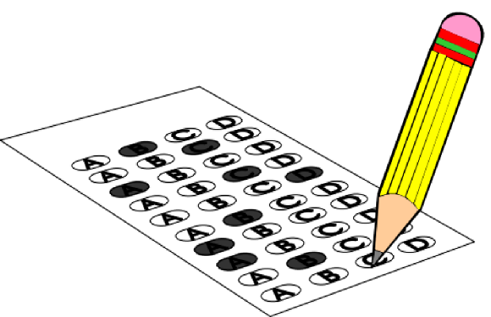
Josie took a long multiple choice test at the end of the year. The ratio of problems Josie got incorrect to the number of questions she got correct is 2:9

Slide 11
Josie took a long multiple choice test at the end of the year. The ratio of problems Josie got incorrect to the number of questions she got correct is 2:9

Slide 12
Josie took a long multiple choice test at the end of the year. The ratio of problems Josie got incorrect to the number of questions she got correct is 2:9

Slide 13
Jasmine and Brenda kept track of the amount of milk they drank each day. Jasmine drank 2 pints of milk each day, and Brenda drank 3 pints of milk each day.
A: What is the ratio of pints of milk Jasmine drank to the amount of pints that Brenda drank?
B: Show this in tape form:

Slide 14
Jasmine and Brenda kept track of the amount of milk they drank each day. Jasmine drank 2 pints of milk each day, and Brenda drank 3 pints of milk each day.
C: If one pint equals 2 cups how many cups did Jasmine drink? How many cups did Brenda drink?
D: Show this in tape form:

Slide 15
Exit Ticket Questions

Slide 16
Homework
Due:
exit ticket questions 1-4
(7.2) page 348 1-9

