Slide 1
Ratios Module 1: Lesson 4

Slide 2
Two out of every three seventh grade student at NOJH have an overdue library book. Jamie said, “That means that 24 of us have over due books!” Grace argued, “No way. That is too low of a number!”
What do we need to know to figure out who is right?
If there are 92 seventh graders at NOJH would Grace be right, or Jamie be right?

Slide 3
First decided if the following ratios bellow are equivalent.
If they are not equivalent find a ratio that is equivalent to the first ratio listed.
If they are equivalent, find a number that was multiply to the first one to find the second one.
6:11 and 42:88
0:5 and 0:20
5:40 and 2:25
Equivalent
8
Equivalent
4
Non-Equivalent

Slide 4
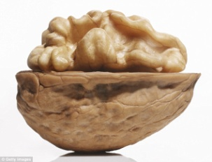
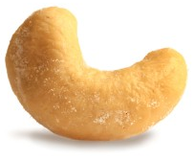
In a bag of mixed nuts of walnuts and cashews, the ratio is 5:6. Determine the number of walnuts that are in the bag if there are .
Use a tape diagram to support your work. Then tell
us the new ratio that supports your answer.
54 Cashews
12 Cashews
120 Cashews
=

Slide 5
There are 35 boys in the 6th grade. The number of girls in the 6th grade is 42. Lonnie says that the ratio of boys to girls is 5:7. Is Lonnie correct or not. Use a tape diagram to prove if this correct or not.

Slide 6
Draw tape diagrams to show that the ratios
2:3 4:6 and 8:12
are all equivalent

Slide 8
Homework
Due: Monday September 12th
exit ticket questions 1-3
(7.2) page 348 10-18

