Slide 1
Ratios Module 1: Lesson 5

Slide 2
We are interested in the different types of vehicles that travel in our town. In August 96 registrations were purchased for passenger cars, and pick up trucks. For every 1 passenger car registered 7 trucks were registered. How many of each type were registered in August?
1
1
1
1
1
1
1
1
1
1
1
1
7
7
7
7
7
7
7
7
7
7
7
7
Ratio ___ : ___

Slide 3
Write 3 smaller equivalent ratios for the question below:
1
1
1
1
1
1
1
1
1
1
1
1
Ratio ___ : ___
We are interested in the different types of vehicles that travel in our town. In August
96 registrations were purchased for passenger cars, and pick up trucks. For every
1 passenger car registered 7 trucks were registered. How many of each type were registered in August?
7
7
7
7
7
7
7
7
7
7
7
7
Ratio __:__ __:__ __:__

Slide 4
Describe the 1st ratio that you have come up with
and draw a tape diagram to show that ratio.
We are interested in the different types of vehicles that travel in our town. In August
96 registrations were purchased for passenger cars, and pick up trucks. For every
1 passenger car registered 7 trucks were registered. How many of each type were registered in August?
Ratio ___ : ___

Slide 5
Describe the 2nd ratio that you have come up with
and draw a tape diagram to show that ratio.
We are interested in the different types of vehicles that travel in our town. In August
96 registrations were purchased for passenger cars, and pick up trucks. For every
1 passenger car registered 7 trucks were registered. How many of each type were registered in August?
Ratio ___ : ___

Slide 6
Describe the 3rd ratio that you have come up with
and draw a tape diagram to show that ratio.
We are interested in the different types of vehicles that travel in our town. In August
96 registrations were purchased for passenger cars, and pick up trucks. For every
1 passenger car registered 7 trucks were registered. How many of each type were registered in August?
Ratio ___ : ___

Slide 7
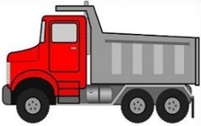
We are interested in the different types of vehicles that travel in our town. In September that for every 14 non commercial vehicles on the road there are 5 commercial vehicles. If there are 108 more non commercial vehicles, how many commercial vehicles are there?
12 | 12 | 12 | 12 | 12 | 12 | 12 | 12 | 12 | 12 | 12 | 12 | 12 | 12
=
These squares represent 108
12 | 12 | 12 | 12 | 12
=
Ratio: __:__
Where do we represent the 108 MORE noncommercial vehicles?
Now how do we find out how much each square represents?
There are a total of 168 noncommercial and 60 commercial vehicles

Slide 8
The ratio of the number of people who use a smart phone to the people who own a flip phone is 4:3. If 500 more people own a smart phone than a flip phone, how many people own each type of phone?
=
500
=

Slide 9
Sammy and David were selling water bottles at the Cherry Days Parade. Sammy sold 5 water bottles for every 3 water bottles that David sold. Together they sold 160 water bottles. How many bottles did each boy sell?
Ratio ___:___
They both total 160. How do we find out how much each square is worth?

Slide 10
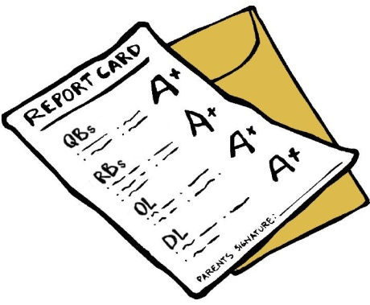
Mrs. Tate and Mr. Johnson were folding report cards to send home to parents. The ratio of the number of report cards Mrs. Tate folded to the number that Mr. Johnson folded is 2:3. At the end of the day together they folded 300 report cards. How many did Mrs. Tate fold? How many did Mr. Johnson fold?
Ratio ___:___
They both total 300. How do we find out how much each square is worth?

Slide 11
At a country concert, the ratio of the number of boys to the number of girls at the concert is 2:7. If there are 250 more girls then how many boys are there?
Ratio ___:___
These squares represent 250 girls.
How do we find out
much 1 square is
worth?

Slide 12
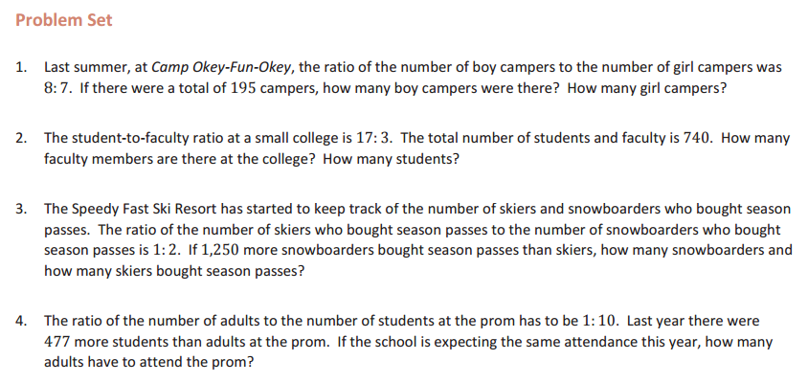

Slide 13
Homework
Due: Wednesday September 14th
exit ticket questions 1-3
ENY 1.5 worksheet (on the backside) questions 1-6

