Slide 1
Ratios Module 1: Lesson 6

Slide 2
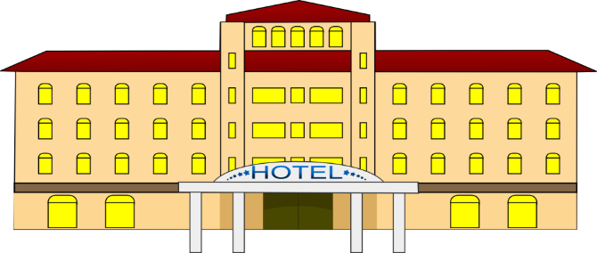
A business hotel had a ratio of full rooms to empty rooms of 2:5 on a Saturday night. On Sunday night the ratio of full rooms to empty rooms is 6:1. If the hotel had 432 full rooms on Sunday, how many did it on Saturday.
Saturday
Sunday
Full
Full
Empty
Empty
If the total number of occupied rooms is 432, and there are 6 sections of the tape diagram, how many rooms does each section represent?

Slide 3
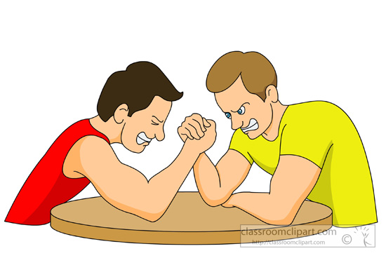
Rob and Todd who are brothers like to make bets on different contests. Before the bet the ratio of the amount of Todd’s money to Rob’s money was 4:7. Rob lost the latest contest and now the ratio of the amount of Todd’s money to Rob’s money is 8:3. If Rob had $280 before the last competition, how much does he have now?
Before
After
Todd
Todd
40 | 40 | 40 | 40 | 40 | 40 | 40
$280
40 | 40 | 40
$120
Rob
Rob

Slide 4
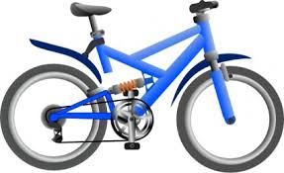
A sporting goods store were ordering new bikes and scooters for there store. For every 3 bikes that were ordered 4 scooters were ordered. But the bikes were selling better than the scooters. So on the second order the number of bikes to scooters ordered were 5:2. If 64 scooters were originally ordered how many bikes were ordered during the second order. __________________________
First Order
Second Order
16 | 16 | 16
=48
16 | 16 | 16 | 16 | 16
=80
16 | 16 | 16 | 16
=64
16 | 16
=32
= 224
How many bikes and scooters were purchased in both orders?

Slide 5
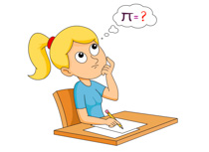
At the beginning of 6th grade the ratio of students who passes the math test to student who didn’t pass the math test is 3:8. The ratio of the students who passed the test at the end of the year was 4:7. 92 total students passes the math test the second time. How many students passed the test the second time but not the first time? _____
1st of the year
2nd of the year
=92
23 | 23 | 23
23 | 23 | 23 | 23

Slide 6
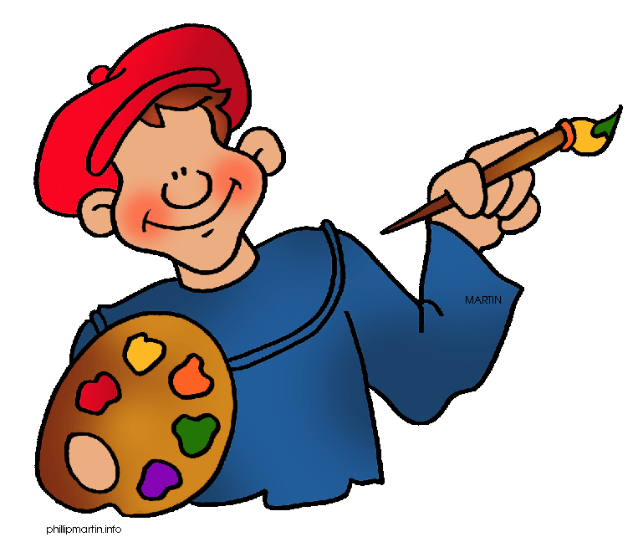
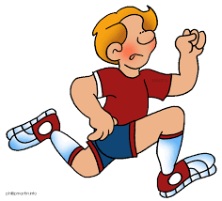
During the 1st semester the ratio of students in art class to the number of students in a gym class was 2:7. During the 2nd semester the ratio of the number of students in art to gym class was 5:4. If 75 students were in art class 2nd semester, how many students were in art and gym the 1st. semester? _____ _____ = ______
15 | 15
15 | 15 | 15 | 15 | 15 | 15 | 15
=135
=75
15 | 15 | 15 | 15 | 15

Slide 7
The amount of money that Jan had in her savings account to her checking account is 1:6. She moved some of her money from the checking account to the savings account. Now the ratio money in her savings account to the amount of money in her checking account is 4:3. If Jane had $936 dollars in her checking account before moving the money. How much does she have in each account after moving the money? Checking : ________ Savings: ____________
=$624
156 | 156 | 156 | 156 | 156 | 156
156 | 156 | 156 | 156
156 | 156 | 156
=$936
=$468

Slide 9
Homework
Due:
exit ticket questions 1-3
ENY 1.6 worksheet (on the backside) questions 1-5

