Slide 1
Ratios Module 1: Lesson 7

Slide 2
Use the image of gumballs below to show things in:
Ratio form:
Fraction Form:
Word form:
Tape form:
7:3
7
3
Seven gumballs to three gumballs

Slide 3
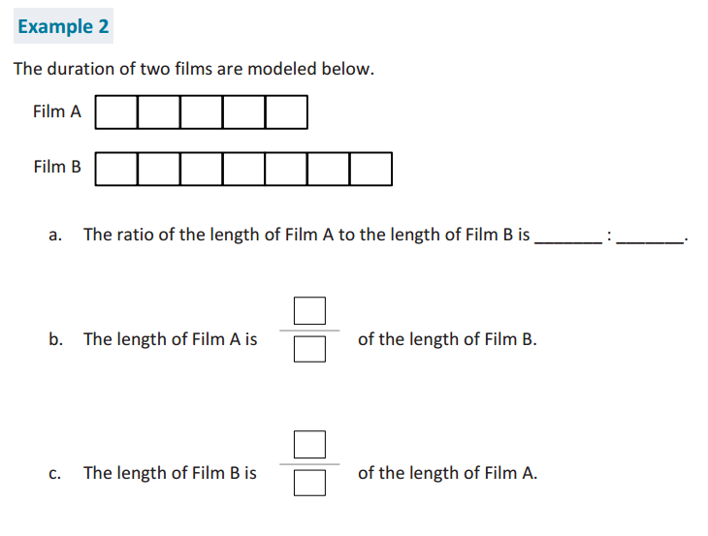
5
7
7
5
5
7

Slide 4
Sam and Kayden brought shrimp to use as fishing bait. Sam brought 8 more pieces of shrimp than Kayden. When they combine their bait together they had 32 pieces of shrimp.
How many shrimp did each boy bring?
Show the extra 8 pieces that were brought
Use a tape diagram to show the unknown pieces of shrimp
Label the total amount of shrimp brought by both boys.
Sam
? Pieces of shrimp
8 more
32 pieces
Kayden
? Pieces of shrimp
Solve for S and K
Write the problem in equation form using variables for unknown numbers:
S + K + 8 = 32

Slide 5
Sam and Kayden brought shrimp to use as fishing bait. Sam brought 8 more pieces of shrimp than Kayden. When they combine their bait together they had 32 pieces of shrimp.
Sammy: ____ Kayden: ____
8 more
32 Whole
20:12
20
12
20:32
20
32

Slide 6
Alyssa family is staying at the lake house for the weekend for a reunion. She is in charge of making pancakes for the whole group. The pancake mix
requires 2 cups of flour for every 10 pancakes.
Write a ratio to show the ratio between cups of flour and pancakes:
Show the value of this ratio using fraction form:
So for every 1 cup of flour we can make ____ pancakes.
If Alyssa needs to make 70 pancakes she needs ______ cups of flour.

Slide 7
A food company is asking people what type of peanut butter they like the best. Their new extra crunchy peanut butter which uses double the amount of peanuts, or the old crunchy peanut butter. They found out that 5 out of every 9 people liked the new extra crunchy best.
Write in Ratio Form:

Slide 8
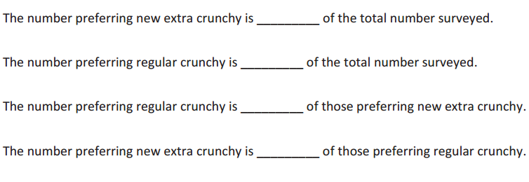
A food company is asking people what type of peanut butter they like the best. Their new extra crunchy peanut butter which uses double the amount of peanuts, or the old crunchy peanut butter. They found out that 5 out of every 9 people liked the new extra crunchy best.
Write in Fraction Form:

Slide 9
If the company makes 90,000 containers of extra crunchy peanut butter, how many containers should they make of regular crunchy?
Extra Crunchy P.B.
Crunchy P.B.
5:9
90,000 ?
The company should make _______ of regular crunchy jars.
72,000

Slide 10
Extra Crunchy P.B.
Crunchy P.B.
5:9
? 2,000
3,000 ?
10,000 ?
2,500
8,000
2,400

Slide 11
Homework
Due: Wednesday September 21st
exit ticket questions 1-2
7.3 math book on page 354 questions 1-12

