Slide 1
Ratios Module 1: Lesson 9

Slide 2
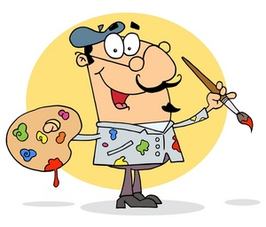
To make Paper Mache an art teacher needs to mix 2 cups of water for every 3 cups of flour to make the paste. Use the table below to find equivalent ratios to double, triple, quadruple, and so on
Cups of Water | Cups of Flour | Ratio
2 | 3
3
4
5
6
7
8
What does this ratio mean? For every 2 cups of water, there are 3 cups of flour.
Why is it worded, “for every 2 cups of water, there are 3 cups of flour”?
Why would I do it more than once?
How do we know if we can make a smaller ratio with a value of 2 to 3?
What is the value of each ratio in the table?
What patterns do you recognize?

Slide 3
$210 for every
3
6
9
12
15
18
21
24
210
The value of 1 square is _____ so use that to fill in the rest of the table.
70
70
70
=
4,000
=21 pages

Slide 4
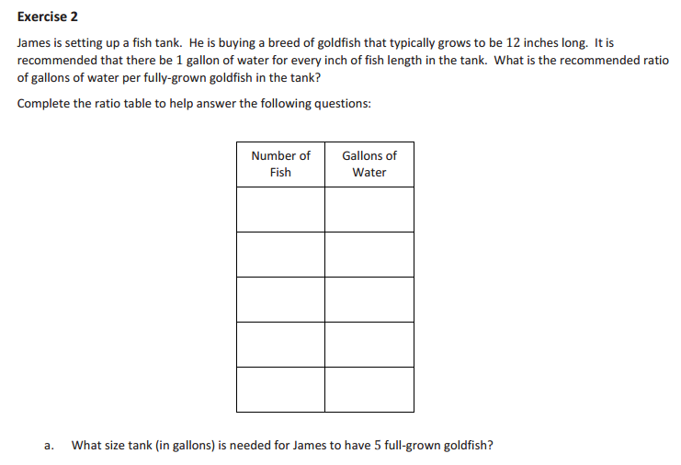
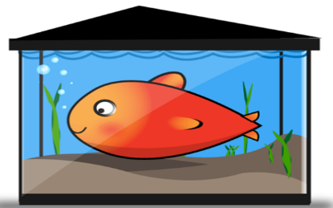
If I buy some gold fish that can grow up to 12 inches long, and there needs to be 1 gallon of water in the tank for every inch of the fish’s length, how much water will I need in the tank if I buy 1 fish, 2 fish, 3 fish, 4 fish, or 5 fish.
96 gallons
What size of tank would I need if I bought 8 fish? ______

Slide 5
3 fish
How many fish can fit in a 40 gallon tank? ______
600 gallons
How big would the tank have to be to fit 50 fish? ____________

Slide 6
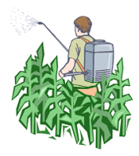
A Farmer in the area sprays his plants to keep them from growing fungus on them. He uses a all natural spray that uses 2 cups of cornmeal for every 12 gallons of water. Create a table to answer
* How many cups of cornmeal should be added to 48 gallons of water.
* How many cups of cornmeal should be added to 72 gallons of water.
* If Paul has 8 cups of corn meal how many gallons of water will he need.
Cups of Cornmeal | Gallons of Water
2 | 12
4 | 24
6 | 36
= 12 gallons
=

Slide 7
Fill in the empty spaces within each table: what is the pattern?

Slide 9
Homework
Due:
exit ticket questions 1-2
6.1 page 284 questions 1-4

