Slide 1
Gecko Glue 1.3 Vocabulary Words

Slide 2
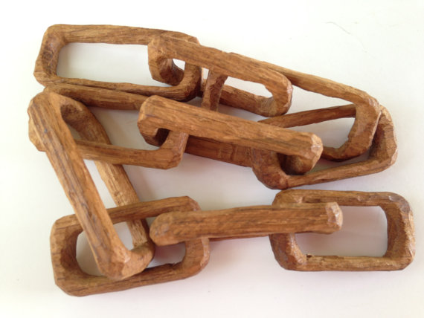
altered
erode
absorb
concentrated
innovation
To change something from its original state.

Slide 3
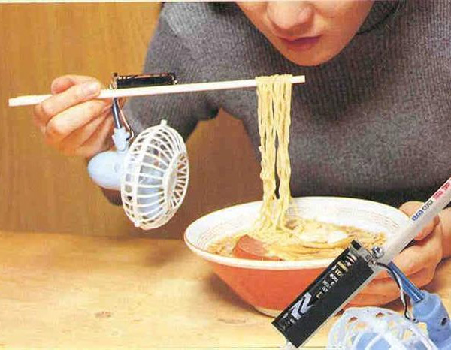
altered
erode
absorb
concentrated
innovation
An invention or new idea.

Slide 4
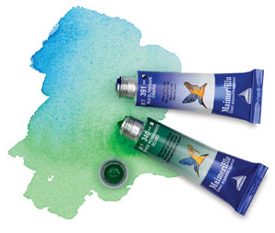
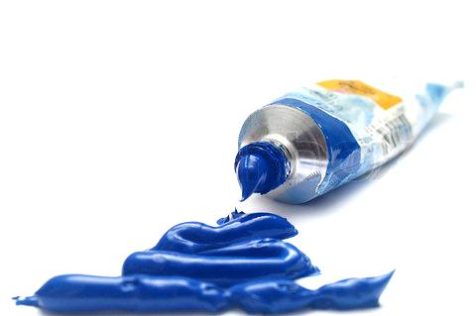
altered
erode
absorb
concentrated
innovation
When a substance is weakened when mixed with something else.

Slide 5
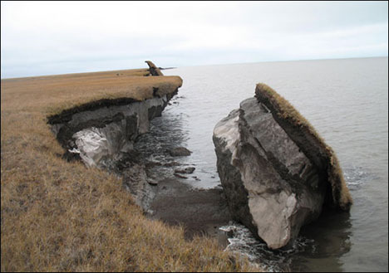
altered
erode
absorb
concentrated
innovation
Wear away. Break down over time.

Slide 6
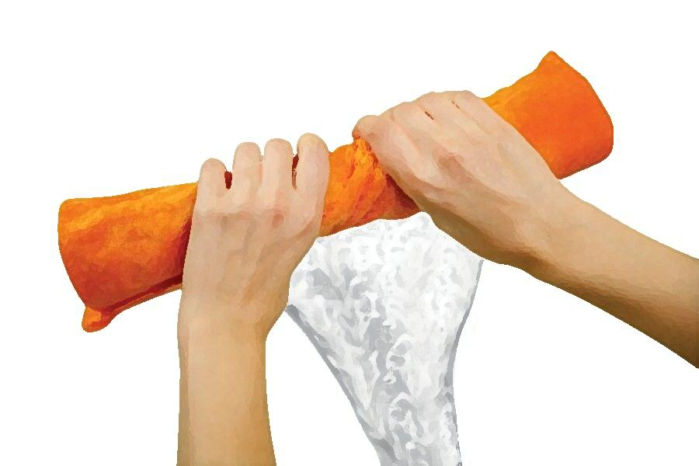
altered
erode
absorb
concentrated
innovation
Take in, or soak up.

