Slide 1
How Tia Lola came to stay 2.1 Vocabulary Words

Slide 2
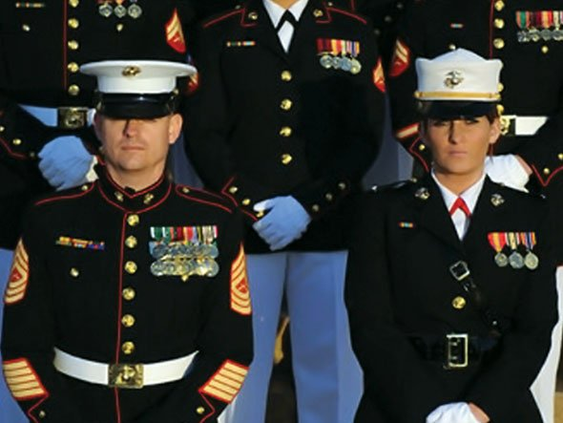
inscribed
grouchy
resemblance
postmark
enthralled
When something is required by someone in authority.
regulation
embarrassment
pennant

Slide 3
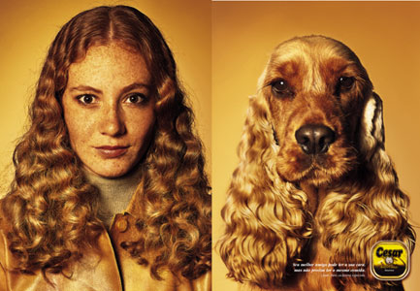
inscribed
grouchy
resemblance
postmark
enthralled
Something that is similar in appearance.
regulation
embarrassment
pennant

Slide 4
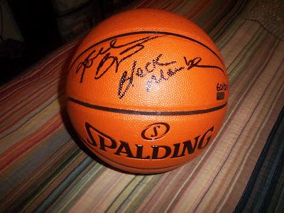
inscribed
grouchy
resemblance
postmark
enthralled
regulation
Something that is written, or etched upon.
embarrassment
pennant

Slide 5
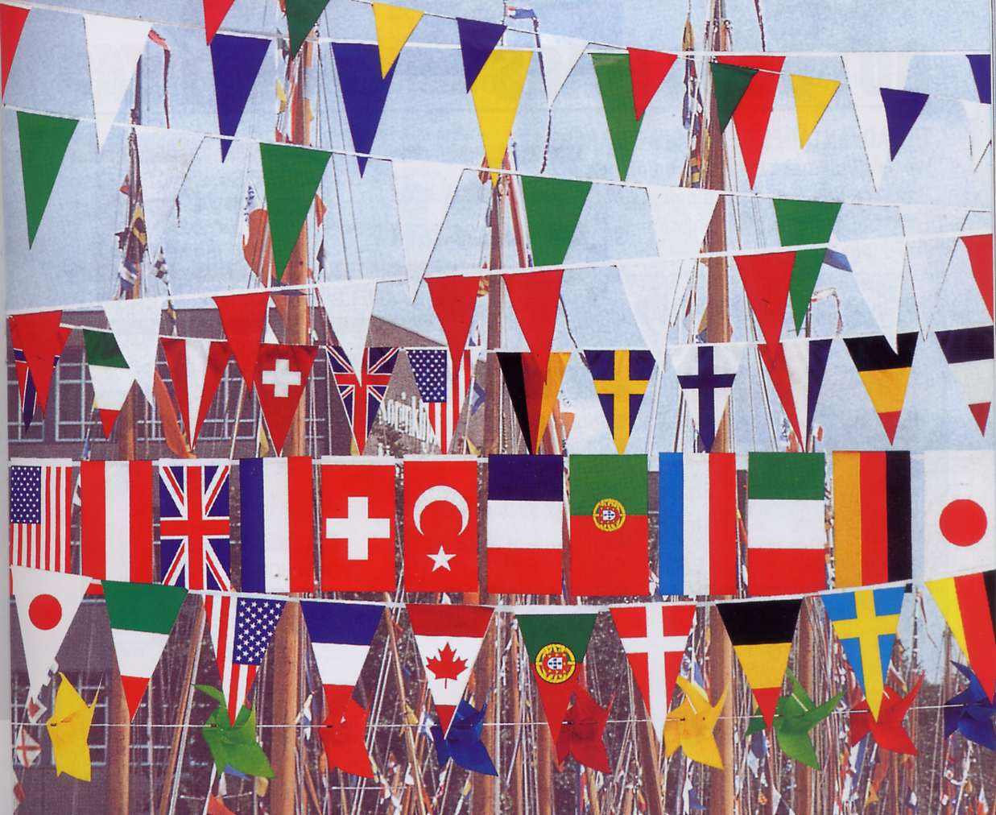
inscribed
grouchy
resemblance
postmark
enthralled
A flag that identifies someone or something.
regulation
embarrassment
pennant

Slide 6
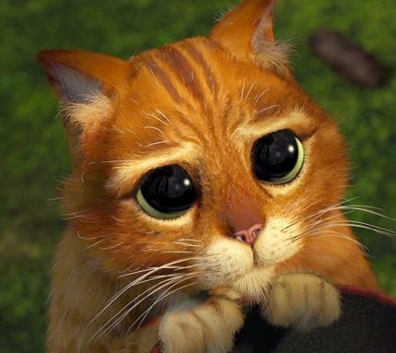
inscribed
grouchy
resemblance
postmark
enthralled
Excited and charmed by something, or someone.
regulation
embarrassment
pennant

Slide 7
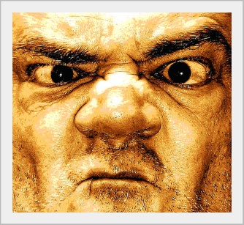
inscribed
grouchy
resemblance
postmark
enthralled
regulation
A person who is in a bad mood.
embarrassment
pennant

Slide 8
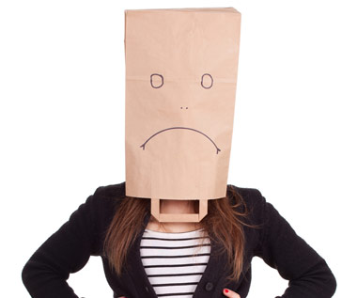
inscribed
grouchy
resemblance
postmark
enthralled
Causes a person to feel ashamed or self-conscious.
regulation
embarrassment
pennant

Slide 9
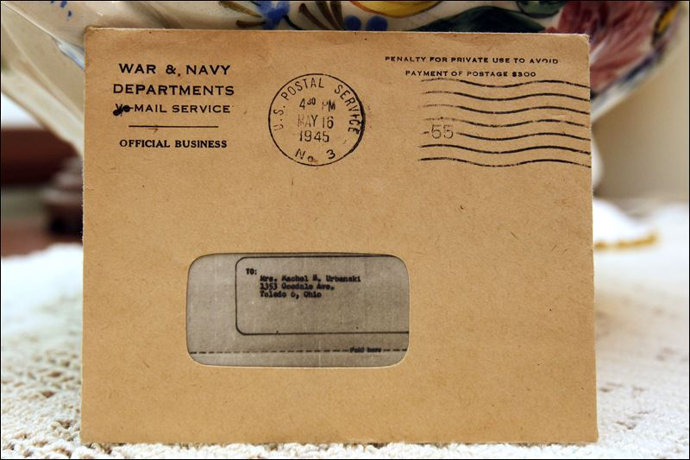
inscribed
grouchy
resemblance
postmark
enthralled
A letter that has been stamped by the post office.
regulation
embarrassment
pennant

