Slide 1
Interrupted Journey 1.5 Vocabulary Words

Slide 2
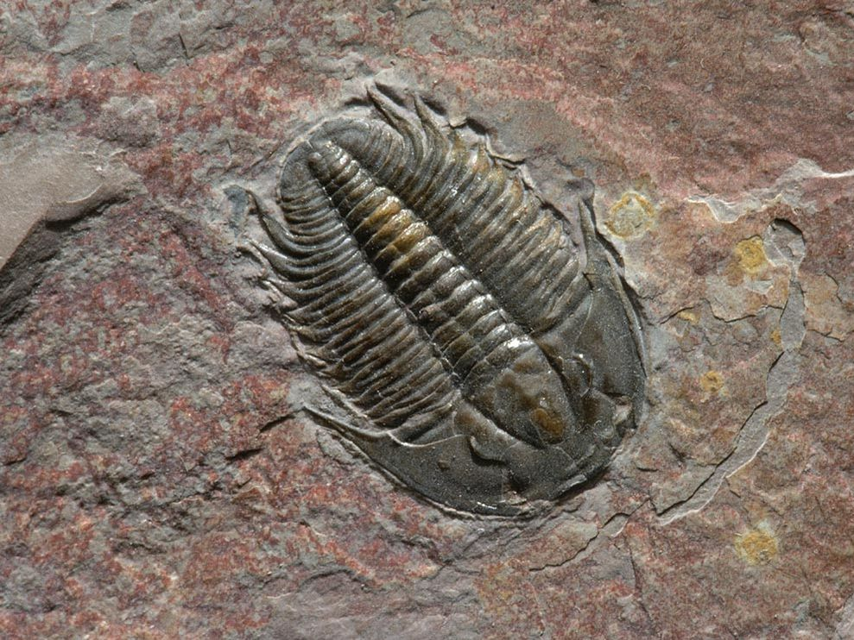
conserve
analyzing
vital
propelled
sedated
dehydrated
pressed into, or made the central part of something.
embedded
speculated

Slide 3
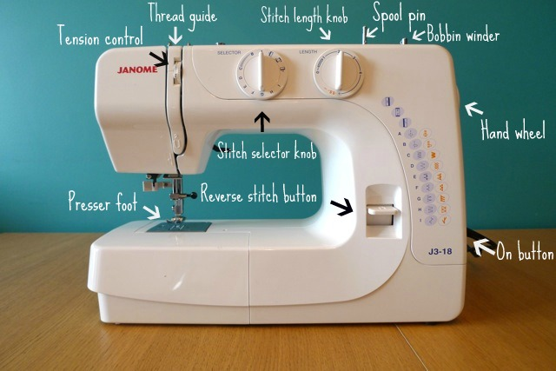
conserve
analyzing
vital
propelled
sedated
dehydrated
To examine all the parts.
embedded
speculated

Slide 4
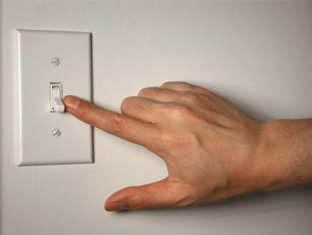
conserve
analyzing
vital
propelled
sedated
dehydrated
Something you save.
embedded
speculated

Slide 5
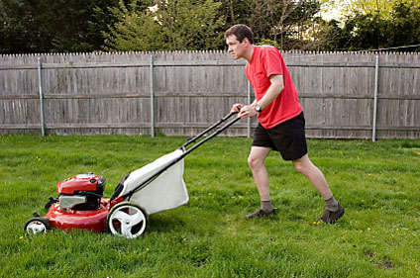
conserve
analyzing
vital
propelled
sedated
dehydrated
When something is pushed forward.
embedded
speculated

Slide 6
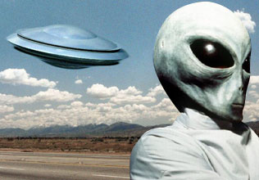
conserve
analyzing
vital
propelled
sedated
dehydrated
When an idea is assumed to be true without real proof.
embedded
speculated

Slide 7
conserve
analyzing
vital
propelled
sedated
dehydrated
If someone has lost a lot of water, and is very thirsty.
embedded
speculated

Slide 8
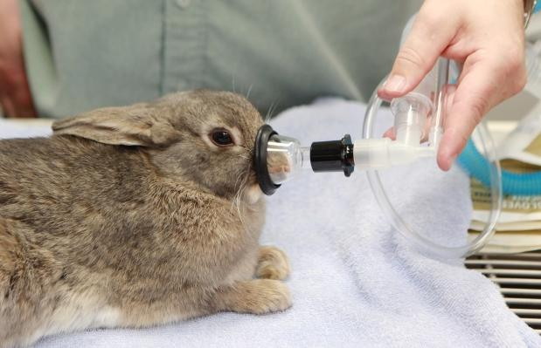
conserve
analyzing
vital
propelled
sedated
dehydrated
When a person or animal is calmed using medicine.
embedded
speculated

Slide 9
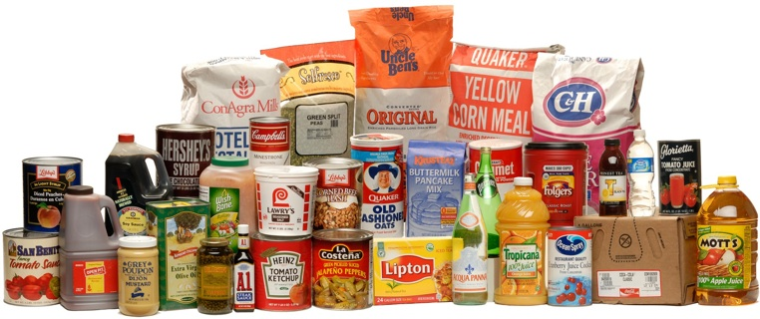
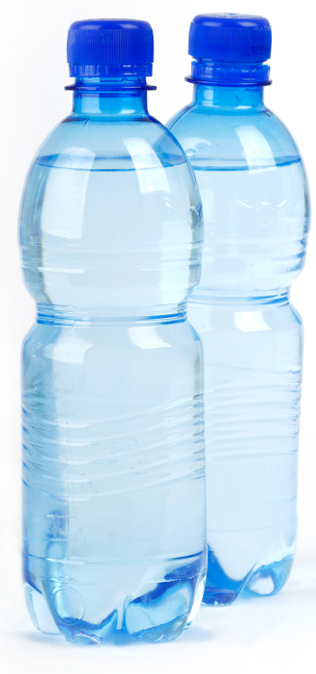
conserve
analyzing
vital
propelled
sedated
dehydrated
Something of great importance.
embedded
speculated

