Slide 1
LOST CITY 1.2 Vocabulary Words

Slide 2
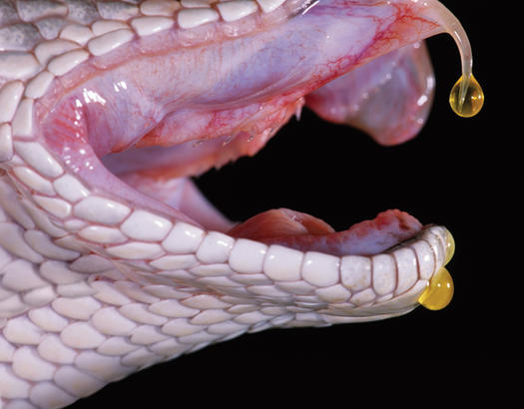
remote
escort
interpreter
vegetation
undergrowth
venomous
Inflicting a poisonous wound.
withstood
foretold

Slide 3
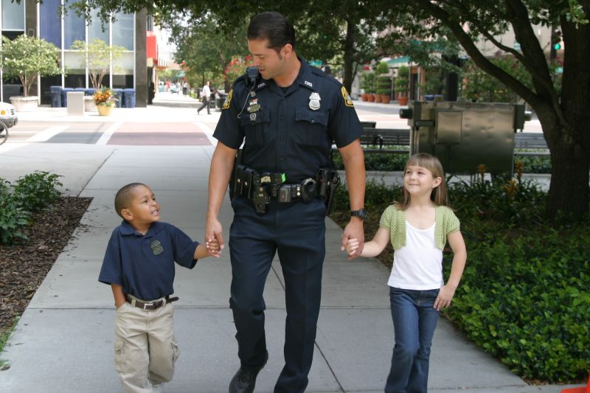
remote
escort
interpreter
vegetation
undergrowth
venomous
A person who provides you with company or protection.
withstood
foretold

Slide 4
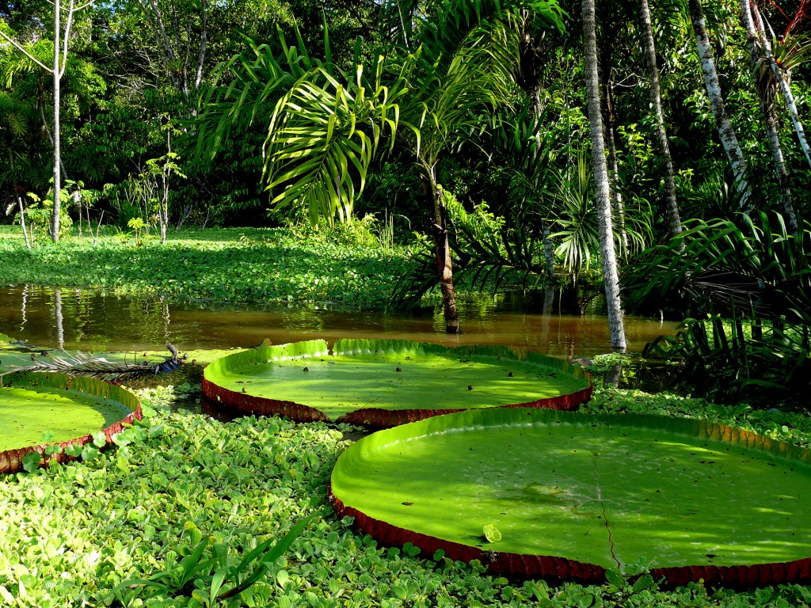
remote
escort
interpreter
vegetation
undergrowth
venomous
withstood
Describes the plant life in a specific area.
foretold

Slide 5
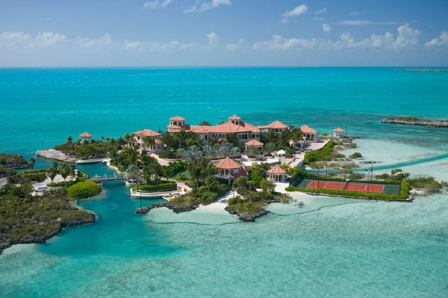
remote
escort
interpreter
vegetation
undergrowth
venomous
secluded or far away from others.
withstood
foretold

Slide 6
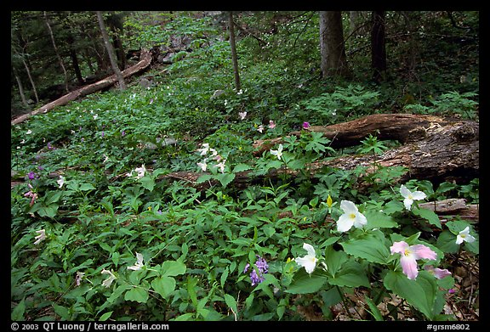
remote
escort
interpreter
vegetation
undergrowth
venomous
The plant life that covers a forest ground.
withstood
foretold

Slide 7
remote
escort
interpreter
vegetation
undergrowth
venomous
To be warned of something before it happens.
withstood
foretold

Slide 8
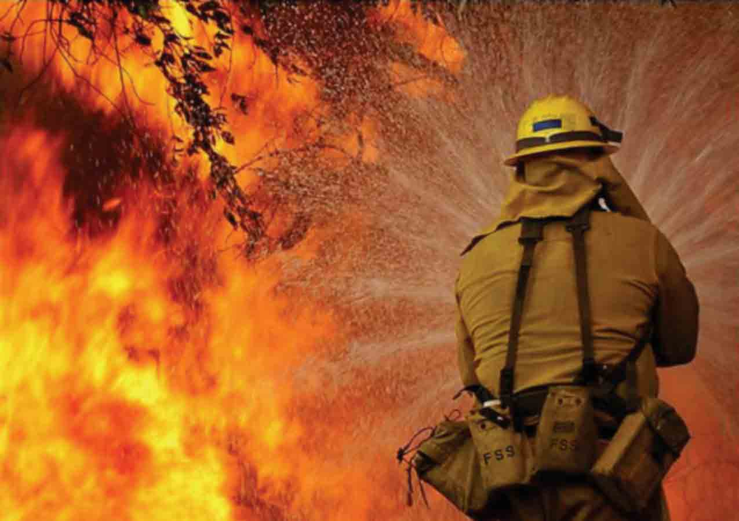
remote
escort
interpreter
vegetation
undergrowth
venomous
To endure or survive when pressed upon.
withstood
foretold

Slide 9
A person who translates conversations between people who speak different languages.
remote
escort
interpreter
vegetation
undergrowth
venomous
withstood
foretold

