Slide 1
Magic Gourd 1.4 Vocabulary Words

Slide 2
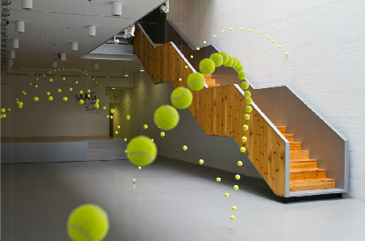
rummaged
undetected
generosity
pathetic
ricocheting
famine
Bouncing from one surface to another surface.
scrounging
chameleon

Slide 3
rummaged
undetected
generosity
pathetic
ricocheting
famine
To search through in a thorough way.
scrounging
chameleon

Slide 4
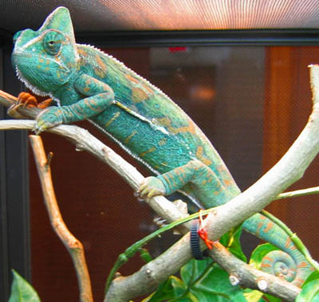
rummaged
undetected
generosity
pathetic
ricocheting
famine
A small, lizard that changes it’s colors.
scrounging
chameleon

Slide 5
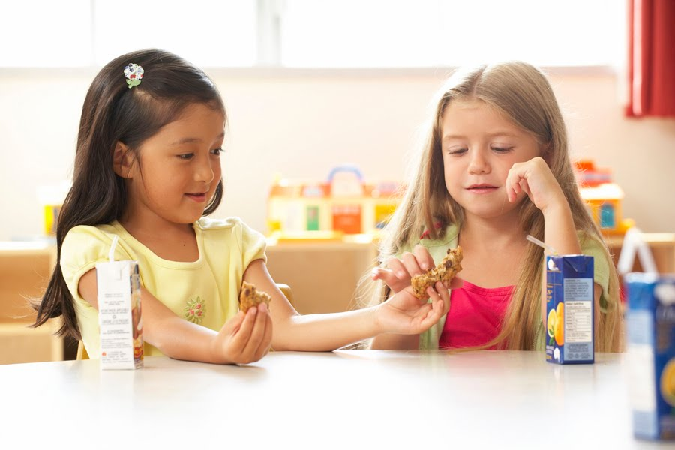
rummaged
undetected
generosity
pathetic
ricocheting
famine
Being kind and giving to others.
scrounging
chameleon

Slide 6
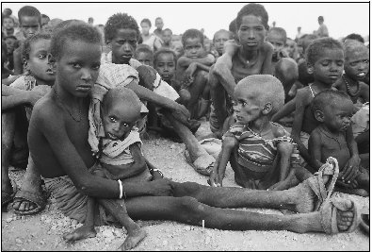
rummaged
undetected
generosity
pathetic
ricocheting
famine
An extreme lack or loss of food.
scrounging
chameleon

Slide 7
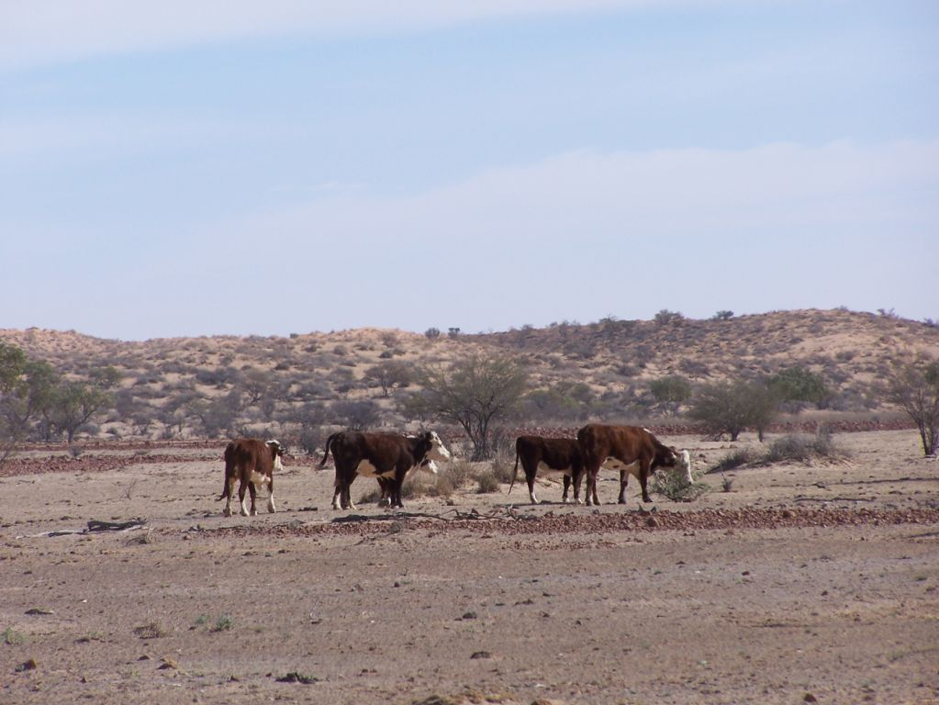
rummaged
undetected
generosity
pathetic
ricocheting
famine
Checking every available source. Difficult to collect.
scrounging
chameleon

Slide 8
rummaged
undetected
generosity
pathetic
ricocheting
famine
To cause others to feel sorry for them.
scrounging
chameleon

Slide 9
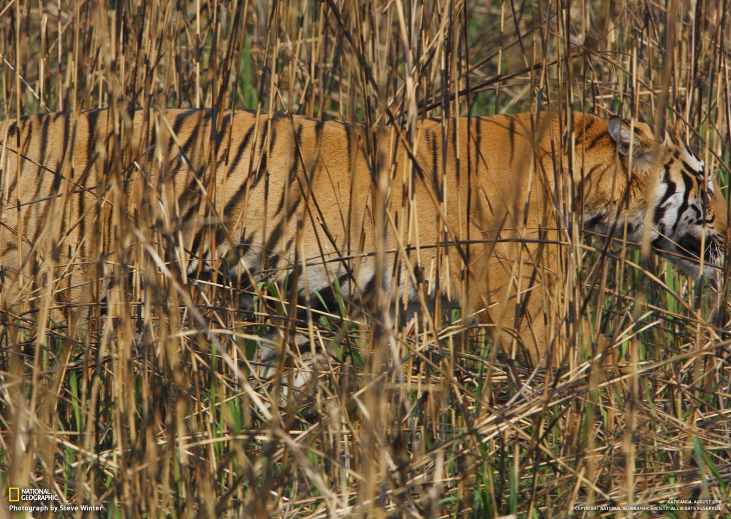
rummaged
undetected
generosity
pathetic
ricocheting
famine
Something that goes unnoticed.
scrounging
chameleon

