Slide 1
The night of the Pomegranate 2.2 Vocabulary Words

Slide 2
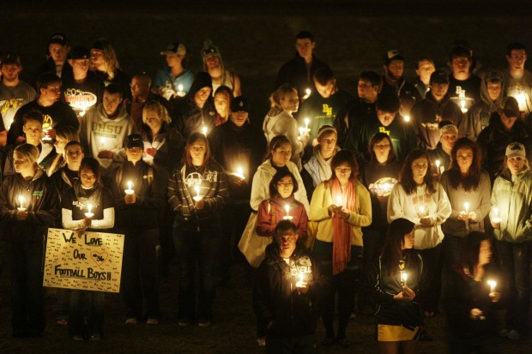
spicy
unsatisfactory
undone
ravaged
broadcast
calculations
A solemn time used for watching and observing.
vigil
marveled

Slide 3
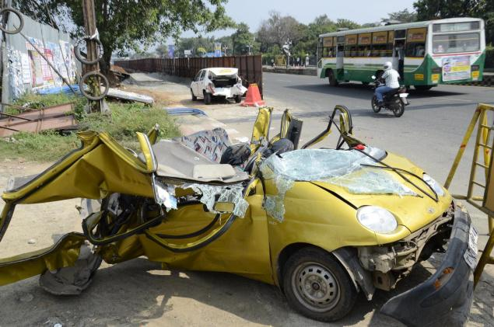
spicy
unsatisfactory
undone
ravaged
broadcast
calculations
When something is destroyed.
vigil
marveled

Slide 4
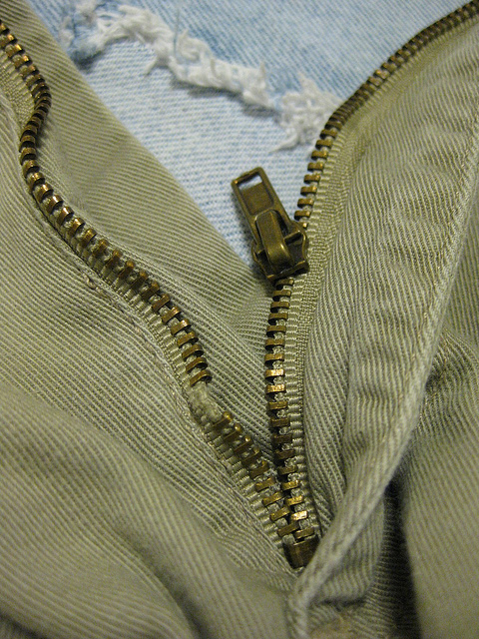
spicy
unsatisfactory
undone
ravaged
broadcast
When something has come apart.
calculations
vigil
marveled

Slide 5
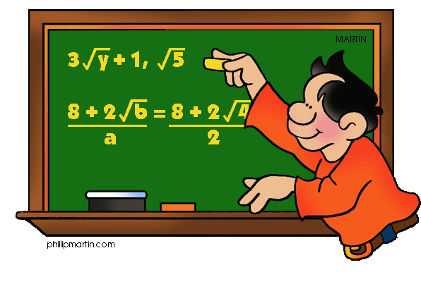
spicy
unsatisfactory
undone
ravaged
broadcast
The results of a mathematical equation or sentence.
calculations
vigil
marveled

Slide 6
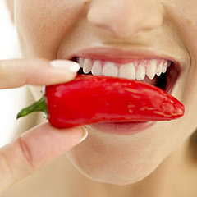
spicy
unsatisfactory
undone
ravaged
broadcast
A food that is strongly seasoned.
calculations
vigil
marveled

Slide 7
spicy
unsatisfactory
undone
ravaged
broadcast
To be filled with feelings of wonder.
calculations
vigil
marveled

Slide 8
spicy
unsatisfactory
undone
ravaged
broadcast
A message that is sent though the TV or Radio.
calculations
vigil
marveled

Slide 9
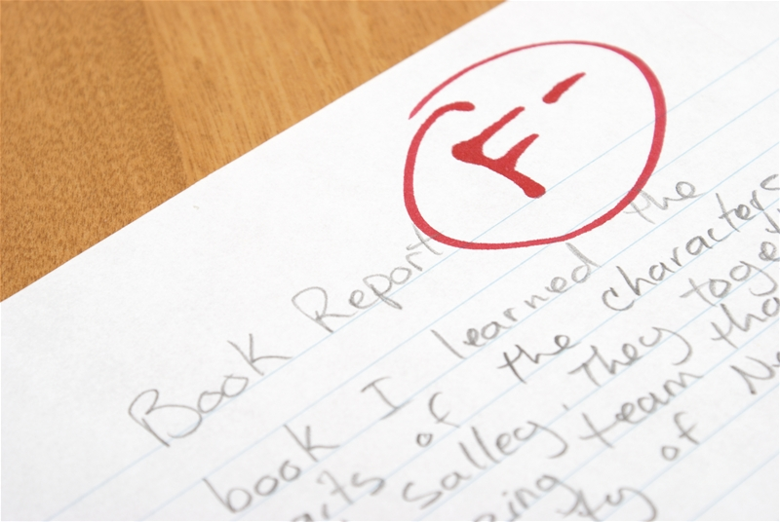
spicy
unsatisfactory
undone
ravaged
broadcast
Not sufficient or not done good enough.
calculations
vigil
marveled

