Slide 1
Summer of swans 1.1 Vocabulary Words

Slide 2
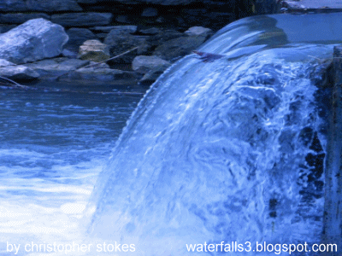
anxiety
conscious
intersection
engulf
procedure
souvenir
Something that falls downward like water.
abruptly
cascade

Slide 3
anxiety
conscious
intersection
engulf
procedure
souvenir
To swallow up or surround you completely .
abruptly
cascade

Slide 4
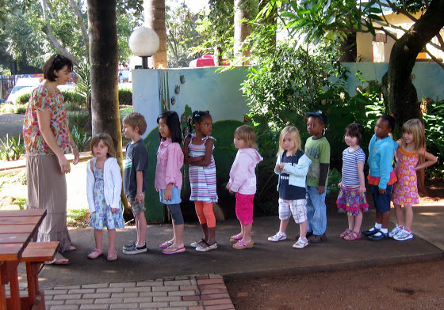
anxiety
conscious
intersection
engulf
procedure
souvenir
A standard or usual way of doing things.
abruptly
cascade

Slide 5
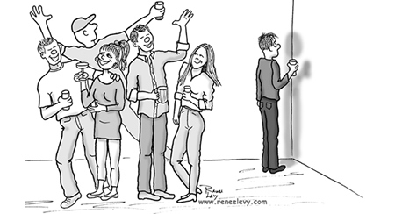
anxiety
conscious
intersection
engulf
procedure
souvenir
A feeling of being nervous, and afraid.
abruptly
cascade

Slide 6
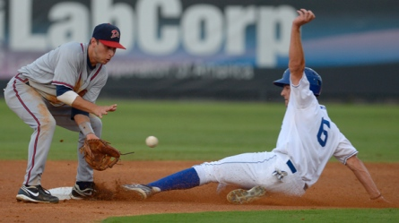
anxiety
conscious
intersection
engulf
procedure
souvenir
To do something quickly without thinking.
abruptly
cascade

Slide 7
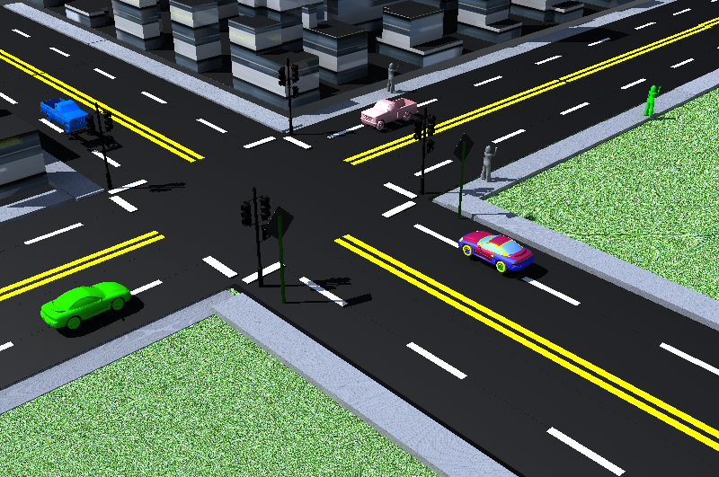
anxiety
conscious
intersection
engulf
procedure
souvenir
A place where two or more roads, lines, or streets meet.
abruptly
cascade

Slide 8
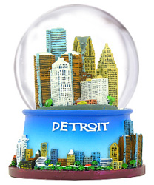
anxiety
conscious
intersection
engulf
procedure
souvenir
A item you buy or collect to remind you of something.
abruptly
cascade

Slide 9
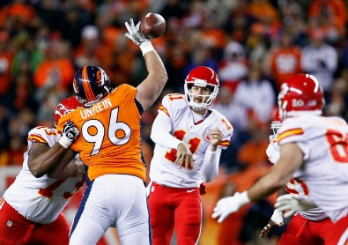
anxiety
conscious
intersection
engulf
procedure
souvenir
Being aware of what is going on around you.
abruptly
cascade

