Slide 1
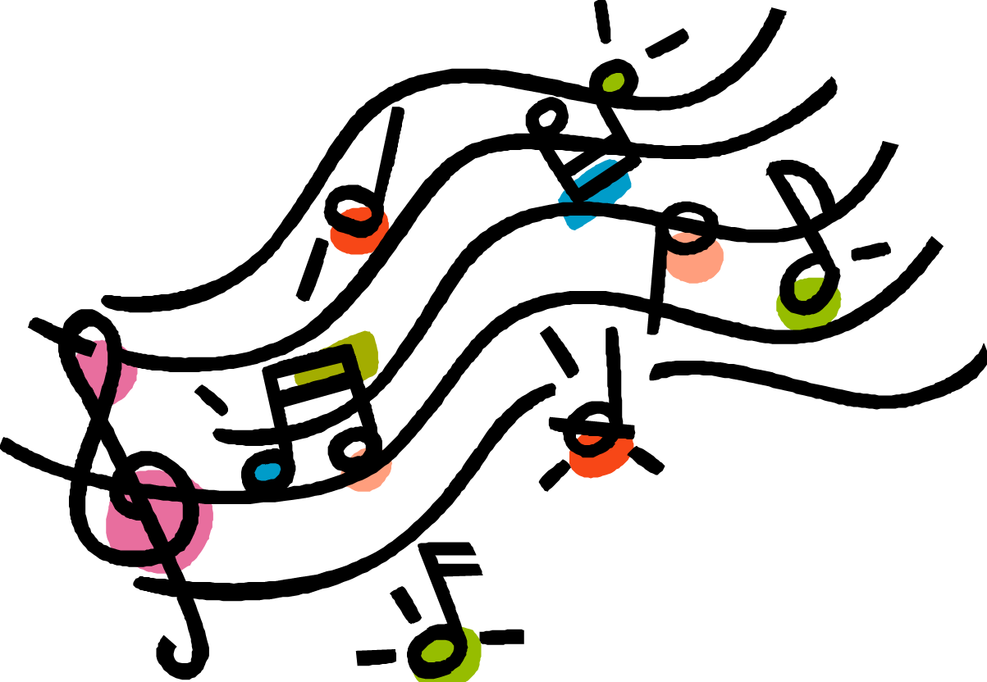
Johnny Grobeck
6th grade Music

Slide 2
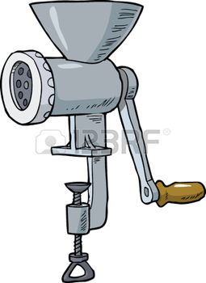
Verse One
There was a man from my hometown
His name was Johnny Grobeck.
He sold a lot of sausages
and sauerkraut by heck.
He made the greatest sausages
The world had ever seen
Till one day he invented,
his sausage making machine!

Slide 3
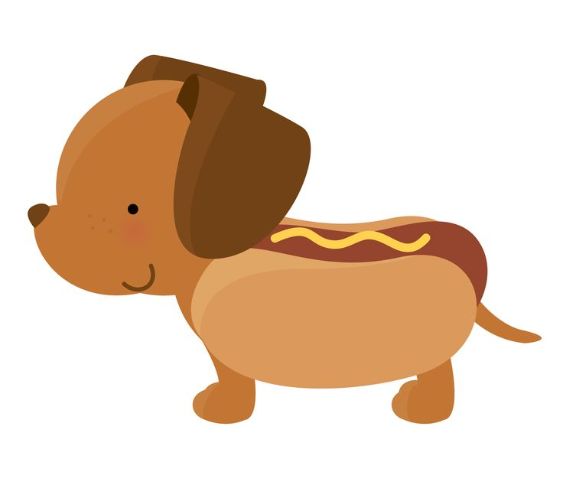
Chorus
Oh mister Jonny Growbeck
How dare you be so mean!
I told you, you'd be sorry for
Inventing that machine.
Now all the neighbors cats and dogs
Will never more be seen.
They all been ground to SAUGAGES
In Johnny Growbeck’s machine!

Slide 4
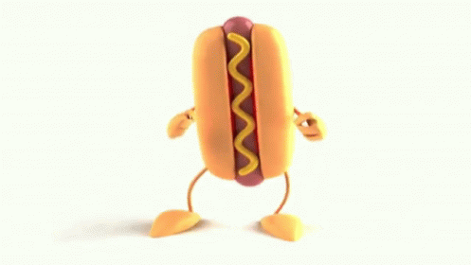
Verse Two
One day a little neighbor boy
came whistling though the door.
He bought a pack of sausages
and laid them on the floor.
Now he began to whistle
he whistled up a tune.
And all the little sausages
Went dancing around the room.

Slide 5
Chorus
Oh mister Jonny Growbeck
How dare you be so mean!
I told you, you'd be sorry for
Inventing that machine.
Now all the neighbors cats and dogs
Will never more be seen.
They all been ground to SAUGAGES
In Johnny Growbeck’s machine!

Slide 6
Verse Three
One night the thing it busted
the darn thing wouldn’t go.
So Johnny Growbeck he climbed
inside to see what made it so
His wife, she had a nightmare
while walking in her sleep.
She gave the crank and awful yank,
and Jonny Growbeck was meat!
Now what?

Slide 7
Chorus
Oh mister Jonny Growbeck
How dare you be so mean!
I told you, you'd be sorry for
Inventing that machine.
Now all the neighbors cats and dogs
Will never more be seen.
They all been ground to SAUGAGES
In Johnny Growbeck’s machine!

