Slide 1
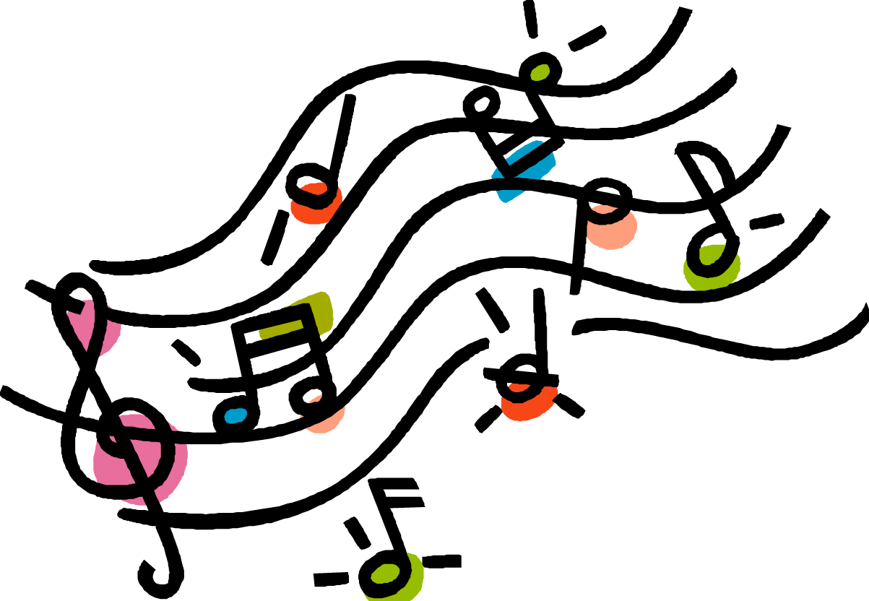
Sleigh ride
6th grade music

Slide 2
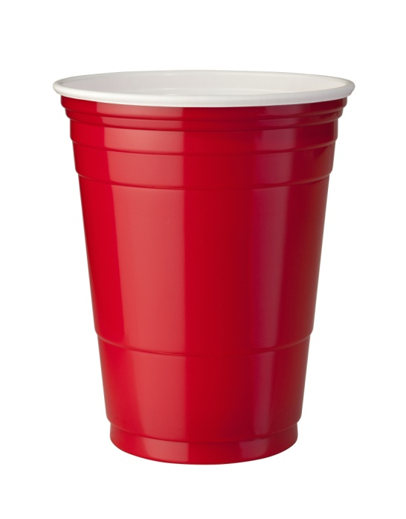
https://www.youtube.com/watch?v=RZf_joR1Srk
:Ukluele guy teaches the cups (youtube)
https://www.youtube.com/watch?v=_KCrdoIKc88
:Sleigh Ride using cups (youtube)
Clap, Clap, tap-tap-tap. Clap, move over.
Clap, bring up, down, exchange, over, hand.

Slide 3
Just hear those sleigh bells jingling, ring ting tingling too. Come on it's lovely weather for a sleigh ride together with you. Outside the snow is falling and friends are calling, "Yoo hoo!" Come on it's lovely weather for a sleigh ride together with you.

Slide 4
Giddy up, giddy up, giddy up, let's go Let's look at the show, we're riding in a wonderland of snow Giddy up, giddy up, giddy up, it's grand just holding your hand We're gliding along with a song of a wintery fairyland

Slide 5
Our cheeks are nice and rosy and comfy cozy are we. We've snuggled up together like two birds of a feather would be. Let's take that road before us and sing a chorus or two. Come on it's lovely weather for a sleigh ride together with you.

Slide 6
There's a birthday party at the home of farm (crack) er Gray It'll be the perfect ending of a per (crack) fect day We'll be singing the songs we love to sing without a single stop At the fireplace we will watch the chestnuts pop, pop, pop, pop

Slide 7
There's a happy feeling nothing in this world (crack) can buy, When they pass around the coffee and the pump (crack) kin pie. It'll nearly be like a picture print by Currier and Ives. These wonderful things are the things we remember all through our lives.

Slide 8
These wonderful things are the things we remember all through our lives.

Slide 9
Just hear those sleigh bells jingling, ring ting tingling too. Come on it's lovely weather for a sleigh ride together with you. Outside the snow is falling and friends are calling, "Yoo hoo!" Come on it's lovely weather for a sleigh ride together with you.

Slide 10
Giddy up, giddy up, giddy up, let's go Let's look at the show, we're riding in a wonderland of snow Giddy up, giddy up, giddy up, it's grand just holding your hand We're gliding along with a song of a wintery fairyland

Slide 11
Our cheeks are nice and rosy and comfy cozy are we. We've snuggled up together like two birds of a feather would be. Let's take that road before us and sing a chorus or two. Come on it's lovely weather …
(wait-wait) lovely weather...
(wait-wait) lovely weather for a sleigh ride together with you.

Slide 12
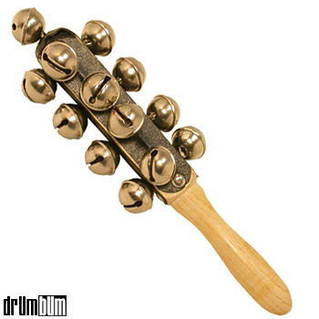
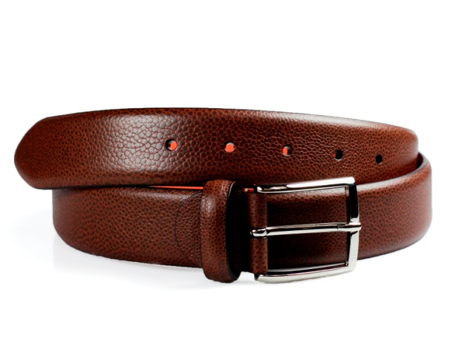
Now let’s do it with percussion!

